Slide 1
Sustainable Development
AGRICULTURE
PRESENTER
EVENT
SHAIVAS
UDAY GANGAL
AAYUSH GUPTA
KARTIKEY NEGI
SHUBH SHARMA
SHIKHAR MISRA
HACKIN’ WINTERS
17th-20th January 2025

Slide 2
Sustainable Development
AGRICULTURE
2
Table of Contents
3
4
5
6
PROBLEM STATEMENT
SOLUTION
TECH STACK
DEMO
7
8
9
10
SHAIVAS
CHALLENGES AND LEARNINGS
FUTURE SCOPE
CONCLUSION
Q&A

Slide 3
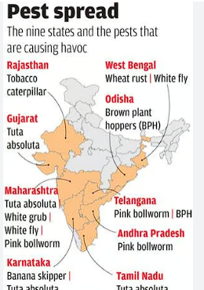
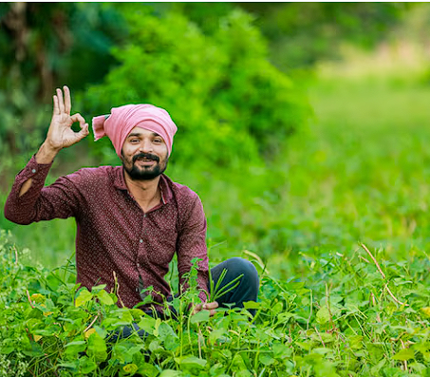

Sustainable Development
AGRICULTURE
3
PROBLEM STATEMENT
Farmers struggle to monitor their crops and receive real-time insights into
pests, diseases, and weather.
3
4
5
PROBLEM STATEMENT
SOLUTION
TECH STACK
7
8
9
SHAIVAS
CHALLENGES AND LEARNINGS
FUTURE SCOPE
CONCLUSION

Slide 4
Sustainable Development
AGRICULTURE
Table of Contents
3
4
5
6
PROBLEM STATEMENT
SOLUTION
TECH STACK
DEMO
7
8
9
10
SHAIVAS
CHALLENGES AND LEARNINGS
FUTURE SCOPE
CONCLUSION
Q&A

Slide 5
Suistainable Development
AGRICULTURE
4
SOLUTION
3
4
5
✅ AI-Based Predictions & Recommendations.
Fertilizer Recommendation to optimize soil health and boost productivity.
Yield Prediction to help farmers plan better and maximize profits.
✅ Real-Time Monitoring & Risk Management
Weather Forecasting (powered by Openmeto.com) provides daily insights to mitigate climate-related risks.
Pest Control & Management Solutions using Gemini AI to detect infestations early and suggest appropriate actions.
Rainfall Prediction to assist in efficient irrigation planning.
✅ Data-Driven Decision Making
Crop Rotation Suggestions based on datasets to improve soil fertility and sustainability.
Agricultural Data Portal for access to critical farming statistics and best practices.
Crop Calculator to estimate costs, profits, and optimal resource utilization.
.
PROBLEM STATEMENT
TECH STACK
7
8
9
SHAIVAS
CHALLENGES AND LEARNINGS
FUTURE SCOPE
CONCLUSION

Slide 6
Sustainable Development
AGRICULTURE
Table of Contents
3
4
5
6
PROBLEM STATEMENT
SOLUTION
TECH STACK
DEMO
7
8
9
10
SHAIVAS
CHALLENGES AND LEARNINGS
FUTURE SCOPE
CONCLUSION
Q&A

Slide 7
Sustainable Development
AGRICULTURE
5
TECH STACK
AI-based project designed to provide predictions and recommendations for farmers FEATURES:
Crop Prediction
Crop Recommendation
Fertilizer Recommendation
Rainfall Prediction
Yield Prediction
Pest Control and management solutions
Weather Forecasting
Crop Rotation Suggestion
Agricultural Data Portal
Crop Calculator
Inventory & LifeStock Management
We have used several Api keys like
Datasets for Crop Prediction
Crop Recommendation
Fertilizer Recommendation
Rainfall Prediction
Yield Prediction
Gemini AI for Pests Management and Solutions
Openmeto.com for Agricultural Data portal and Weather Forecasting(day wise)
Datasets for Crop Rotation & Agriculture Data Portal
For Livestock & Inventory Mangement
3
4
5
PROBLEM STATEMENT
SOLUTION
7
8
9
SHAIVAS
CHALLENGES AND LEARNINGS
FUTURE SCOPE
CONCLUSION
We have used Html , CSS , Javascript with backend in Php , stored the data in Mysql

Slide 8
Sustainable Development
AGRICULTURE
Table of Contents
3
4
5
6
PROBLEM STATEMENT
SOLUTION
TECH STACK
DEMO
7
8
9
10
SHAIVAS
CHALLENGES AND LEARNINGS
FUTURE SCOPE
CONCLUSION
Q&A

Slide 9
Sustainable Development
AGRICULTURE
6
DEMO
3
4
5
PROBLEM STATEMENT
SOLUTION
TECH STACK
7
8
9
SHAIVAS
CHALLENGES AND LEARNINGS
FUTURE SCOPE
CONCLUSION

Slide 10
Sustainable Development
AGRICULTURE
Table of Contents
3
4
5
6
PROBLEM STATEMENT
SOLUTION
TECH STACK
DEMO
7
8
9
10
SHAIVAS
CHALLENGES AND LEARNINGS
FUTURE SCOPE
CONCLUSION
Q&A

Slide 11
Sustainable Development
AGRICULTURE
7
CHALLENGES AND LEARNINGS
3
4
5
1️⃣ Accurate AI Predictions
2️⃣ Real-Time Weather & Rainfall Forecasting
3️⃣ Pest Detection & Management
4️⃣ Farmer-Friendly UI/UX
5️⃣ API Limits & Data Security
🔹 AI Predictions: Enhanced accuracy with high-quality datasets. 🔹 Weather Forecasting: Integrated Openmeto.com API for real-time updates. 🔹 Pest Control: Used Gemini AI for early detection.
📌 Repo: https://github.com/Aayush-Creates/SHAIVAS
🚀 Empowering farmers with AI-driven insights for smarter agriculture! 🌱
PROBLEM STATEMENT
SOLUTION
TECH STACK
7
8
9
SHAIVAS
FUTURE SCOPE
CONCLUSION

Slide 12
Sustainable Development
AGRICULTURE
Table of Contents
3
4
5
6
PROBLEM STATEMENT
SOLUTION
TECH STACK
DEMO
7
8
9
10
SHAIVAS
CHALLENGES AND LEARNINGS
FUTURE SCOPE
CONCLUSION
Q&A

Slide 13
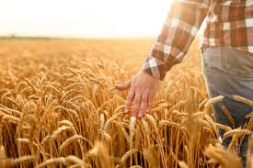
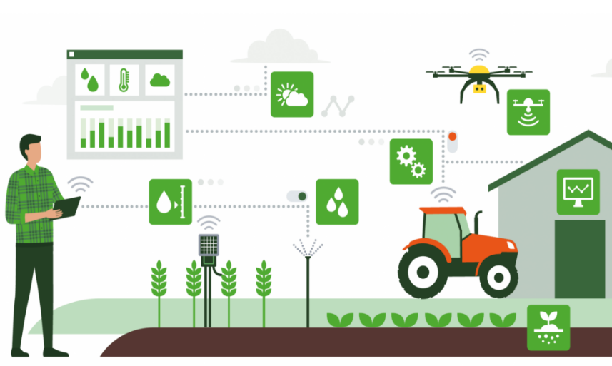
Sustainable Development
AGRICULTURE
8
FUTURE SCOPE
The integration of advanced technologies into agriculture is revolutionizing the industry, paving the way for smarter, more sustainable farming practices. By leveraging tools like the Gemini API and datasets, we can enable precise weather predictions, crop health monitoring, and real-time decision-making to optimize resource use and boost productivity. These innovations empower farmers to better manage their operations, reduce waste, and mitigate risks associated with unpredictable environmental factors.
As we move forward, the future of agriculture will be defined by the increasing adoption of AI, IoT, and data-driven solutions. The aesthetically pleasing and user-friendly website we have developed serves as a bridge between farmers and cutting-edge agricultural insights, ensuring accessibility and ease of use. By enhancing the digital experience, this platform encourages widespread adoption, ultimately contributing to food security, economic growth, and the well-being of farming communities worldwide. Since More people are moving in to become agriculturist we aim to target those people
3
4
5
6
PROBLEM STATEMENT
SOLUTION
TECH STACK
DEMO
SHAIVAS
7
8
9
10
CHALLENGES AND LEARNINGS
CONCLUSION
Q&A

Slide 14
Sustainable Development
AGRICULTURE
Table of Contents
3
4
5
6
PROBLEM STATEMENT
SOLUTION
TECH STACK
DEMO
7
8
9
10
SHAIVAS
CHALLENGES AND LEARNINGS
FUTURE SCOPE
CONCLUSION
Q&A

Slide 15

Sustainable Development
AGRICULTURE
9
Conclusion
Agriculture is the backbone of our economy, yet farmers face immense challenges in monitoring their crops, tackling pests and diseases, and adapting to unpredictable weather conditions. Our AI-powered platform is designed to empower farmers with real-time insights, accurate predictions, and smart recommendations, ensuring better decision-making and higher yields.
3
4
5
6
PROBLEM STATEMENT
SOLUTION
TECH STACK
7
8
9
10
By integrating advanced technologies like AI, machine learning, and real-time data analytics, we aim to bridge the gap between traditional farming and modern innovation. With this initiative, we strive to make agriculture more efficient, sustainable, and profitable—because when farmers thrive, the world thrives. 🌱🚜
SHAIVAS
CHALLENGES AND LEARNINGS
FUTURE SCOPE

Slide 16
Sustainable Development
AGRICULTURE
Table of Contents
3
4
5
6
PROBLEM STATEMENT
SOLUTION
TECH STACK
DEMO
7
8
9
10
SHAIVAS
CHALLENGES AND LEARNINGS
FUTURE SCOPE
CONCLUSION
Q&A

Slide 17

Sustainable Development
AGRICULTURE
10
Q&A
Please feel free to ask any questions, and we will do our best to answer them to the best of our knowledge and experience.
3
4
5
6
PROBLEM STATEMENT
SOLUTION
TECH STACK
DEMO
7
8
9
10
SHAIVAS
CHALLENGES AND LEARNINGS
FUTURE SCOPE
CONCLUSION

Slide 18
The End of Presentation
THANK YOU FOR LISTENING
PRESENTER
SHAIVAS
UDAY GANGAL
Aayush Gupta
Kartikey Negi
Shubh Sharma
Shikhar Misra
DATE
18th to 20th January 2025

